Slide 1
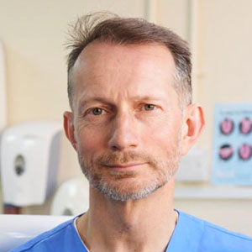
David McColl
Chair, Scottish Dental Practice Committee
Conference of Scottish Local Dental Committees, 23 April 2021

Slide 2
About David
Graduated from Glasgow University in 1987 and currently runs a predominantly NHS practice in Govanhill, Glasgow alongside 3 associates, 2 therapists and 6 DCPs.
Vice Chair of Greater Glasgow and Clyde Local Dental Committee and Past Chair of GGC Area Dental Committee (which has representatives from GDS, PDS, Hospital and University Dental Services).
On the BDA UK Pensions Committee and a board member of The Scottish Public Pensions Authority (SPPA).
My role as SDPC Chair is not a salaried role. Members of the committee are reimbursed for attendance at meetings through the Scottish Dental Fund which in turn is funded via Local Dental Committees. We are not funded for out of meeting activity.
Beyond this I do have a life involving cycling, tennis and ski mountaineering.

Slide 3
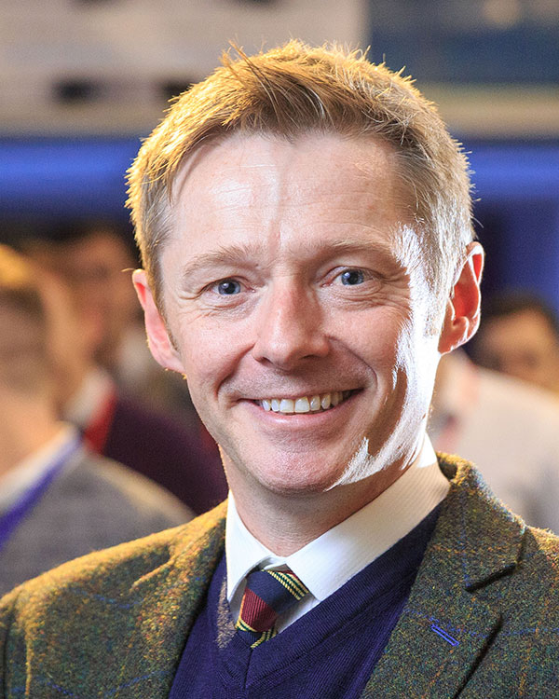
The SDPC
Represents all non-salaried general dental practitioners in Scotland practising in the NHS and/or privately.
Negotiates with NHS Boards, Island Health Boards, and the Scottish Government Directorate for Population and other appropriate bodies on matters relating to the delivery and remuneration of dental services provided by non-salaried general dental practitioners, including orthodontists and assistants working in Scotland. To liaise with the UK General Dental Practice Committee and Scottish Council.
The paper for 2019 motions is available on the conference website.
Committee consists of elected members from board areas and BDA branch representatives
Vice Chair | Kenny McDonald (pictured)
SDPC Executive Sub-committee | Myself and Vice Chair, Donald Morrison, Jeff Ellis, Josephine Weir and Clare Murphy (full committee is 22)
National Director, BDA Scotland | Phil Grigor
Policy Adviser and Secretary to SDPC | Kirsten Phillips

Slide 4
Oral Health Improvement Plan
Investing in prevention
The OHIP wishes to invest in prevention, however this involves trust with the profession.
Scottish Government statistics on Fluoride Varnish application show only 30% of 3-5 year old’s receive FV as part of Childsmile, which is slightly misleading.
The opportunistic figure is 47%.
SDPC has asked for zero codes for many years in order to provide accurate FV data recording.
The profession needs to consider how it can persuade Scottish Government to invest in further prevention within the GDS.

Slide 5
DDRB
The BDA’s written submission has been submitted to DDRB for 20/21. Last year we were awarded an uplift of 2.5% to represent 2.5% on net pay with and 2.5% on the expenses element; however SG did not apply this to the prior approval limit or the GDPA cap.
When questioned over this the response was "We are not minded to". This response was completely unacceptable and we are in discussions with SG on logical methodology on applying uplift.
The BDA’s Oral Evidence was provided in London on 24 February 2020. We asked for an uplift of 5% on net pay. Scotland now represents a different situation with an even higher rate of income tax than the rest of the UK.

Slide 6
DDRB continued
DDRB no longer provides a recommendation on the expenses element.
BDA Scotland, SDPC and Scottish Government have been working together for the fifth time on an exercise to obtain expenses data from Scottish GDPs. If anyone has any ideas on how to get practices to engage I’m all ears. How's £250?
Encourage all practice owners to engage and participate in the exercise to help achieve better expenses awards in future. The information requested is nothing that they cannot already get from PSD and HMRC but the manner in which it is presented is important. This is what we have been working on with SG.

Slide 7
Pensions
I am the Scottish rep on the BDA Pensions Committee which meets twice yearly. Interesting developments include a challenge to the UK Government on the age discrimination on transfer from the 1995 scheme to the 2015 scheme.
David McColl, Phil Grigor and the BDA Pension Lead Phil McEvoy, meet The Scottish Public Pensions Agency annually.
It is an important issue which is not easily understood but it is vital that practitioners receive data from SPPA in a form that can be interpreted.
Everyone should receive:
An Annual Benefit Statement
A Pension Savings Statement

Slide 8
Miscellaneous Issues
• Concerns about restorative reviews and difficulties in referring cases to secondary care.
• Disappointment that the HPV vaccine programme for boys aged 12-13 did not include a catch-up programme for older schoolboys.
• Long-standing concerns about lengthy waiting times for paediatric extractions under general anaesthetic (pre-pandemic, over 1,000 children were waiting in NHS Greater Glasgow and Clyde alone).
• Ongoing liaison with PSD on the e-Dental Programme.

Slide 9
CORONAVIRUS On 23 March 2020 Scottish Government tells practices to stop face to face interaction with patients
We were instructed to provide telephone triage for patients between 9-6 Monday to Friday including public holidays

Slide 10
Financial Implications
The Scottish Government was to pay practitioners an average of the previous year’s gross at 90% excluding the patient charge element. This was going to seriously impact on the finances of the majority of practices.
SDPC could not agree to this and insisted that the patient charge element be paid. SG went to finance to find the additional funding required and agreed to fund 80% of the complete item of service payments including the patient charge and including all capitation and continuing care payments.
SG fund GDS (General Dental Services) and pay out £300m per annum; the additional £75m paid into NHS GDS comes from patient charges. We are effectively the Governments tax collectors.
When practitioners ask why we are not funded at 100%, the reason is that it is not within the budget of the health dept as £75m of the funding comes from patient charges.

Slide 11
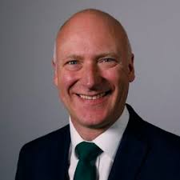
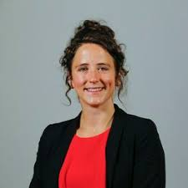
Who are Scottish Government?
The Minister for Public Health and Sport
Joe FitzPatrick, was replaced by Marie Gougeon in December 2020. Marie has a degree in history from Aberdeen University.
Tom Ferris
Chief Dental Officer
Community Dental Service and previous deputy to Margie Taylor, the previous CDO
Gavin McLellan
Interim Deputy Chief Dental Officer
General Dental Practice, previous joint practice owner and now associate
Civil Servants : David Notman, Alex Bowerman, Claudine Duff, Ewan Stuart, Amy Jarvie and Jenny Bloomfield

Slide 12
The Covid Timeline
March/April 2020
56 UDCC’s running in Scotland, staffed by GDS and PDS to see patients who could not be treated by Analgesics, Antibiotics and Advice.
GDS practitioners and their staff volunteered to work in:
UDCCs, NHS 24 and Community Assessment Centres
Practices donated their PPE to:
Hospitals, Care Homes and Pharmacies
Funding
We asked about funding availability for mixed practices. We wrote to the CDO,
Joe FitzPatrick and the Finance Minister Kate Forbes. We sought clarification on furlough and the coronavirus support funding. We liaised with private practitioners to lobby the government for financial support.

Slide 13
The Covid Timeline
May 2020
SDPC had a meeting with PSD who were working remotely. They had been inundated with queries with reference to Covid support payments. To give an idea of the volume, in any one year 800 list numbers change. There are around 3,000 GDS practitioners in Scotland.
SDPC met with SG. The CDO agreed that Covid highlighted that the way dentistry is funded does not work and that it was impossible to return to the SDR and a fee per time delivery model.
SG withdrew CPDa payments (the postgraduate allowance). SDPC insisted for this to be reinstated and after consideration they agreed. SG stated that they were proposing to withdraw seniority payments; following a robust discussion SG decided not to withdraw new applications for seniority payments.
We discussed how to get VDP’s working in UDCC’s, PPE, practice expenses, the situation with mixed practice sustainability, testing for covid in dental patients and a return to practice.

Slide 14
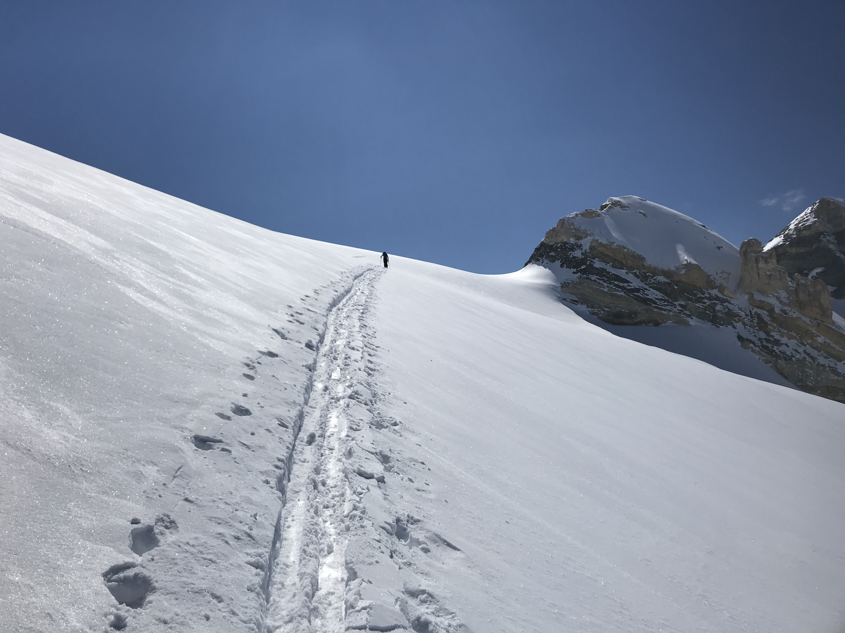
Practice seemed a long way off

Slide 15
The Covid Timeline
June 2020
Practices were allowed to reopen for face-to-face consultations from 22 June with PPE to be supplied by SG through boards.
This indicative date was controlled by the First Minister Nicola Sturgeon with the CDO telling
SDPC that he would not know definitively until the day before or even the morning of the
announcement. The announcement was poorly worded and referred to routine dentistry being
available. We warned SG not to increase public expectation of what was deliverable.
Once the government got their phasing right this was to be deemed Phase 2 of the remobilisation of NHS GDS. The CDO stated at our meeting on 17 June that phases 3 and 4 would not be a return of a fee per item model and that they had been working on something they would share with SDPC.
We sought clarification on:
Risk assessments for teams as they returned to work
Covid testing for patients - they had no plans to test in primary care
VDPs working in UDCCs
Viability of mixed practice - CDO stated it was out with his budget
Key worker status for dental teams - CDO said it was up to local councils
Access to Electronic Care Summaries for GDS
Coronavirus support fund - SG had little knowledge as it was managed by councils

Slide 16
The Covid Timeline
July 2020
We were presented with an SDR which was simply to measure activity; SDPC had little involvement in the final draft which was presented to us as a 131-page document with a turnaround time of a day to agree to it.
We sent emails to the CDO which remained unanswered and a hiatus of 2 weeks passed between the SDPC Executive Sub-committee having sight and commenting on the draft SDR and receiving it on Friday afternoon when SG planned to send it to the profession on the Monday.
SDPC requested a meeting with the Minister Joe FitzPatrick to discuss our extreme disappointment with the CDO and his team over the levels of regular and timely communication and engagement with SDPC and the profession.
We met with the Minister on July 22 and discussed:
Poor communication with the profession
Open courses of treatment (Following no discussion, SG instructed practitioners to submit all open courses and these payments were to be deducted from the Covid support payments. SDPC insisted that this was unfair and possibly discriminatory)
Long term future of dentistry - we urged SG to start working on this ASAP

Slide 17
The Covid Timeline
August 2020
Flu vaccine delivery
SDPC indicated that practices should be given the option of delivering the vaccine given that vaccinating 4.5 million people in Scotland was going to be a mammoth task for the NHS and it would bring much needed additional funding into dentistry.
Open courses of treatment
Following SDPC opposition, SG forwarded this to their legal department for consideration.
Ventilation and fallow time
The 81-page review document was published and caused even more stress and angst in an already stressed profession. Standard fallow time being 1 hour unless following risk mitigation this could be evidenced and reduced.
VDPs
To start 1 September and VDPs on completion were to be paid by SG but no additional
funding for the practice into which they had secured a position. We are still pushing this as a real live problem.
AGPs
Into practice from 17 August with the fit testing and delivery of PPE including the 3M
1863 mask to be supplied by NSS and delivered through boards.

Slide 18
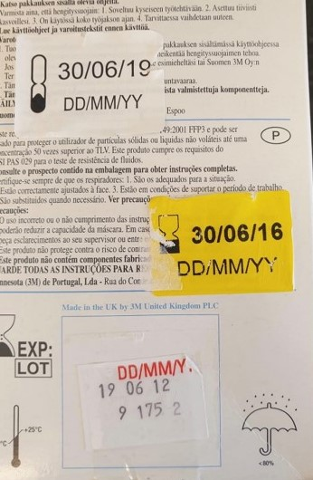
The Mask
Boxes of the 3M 1863 masks were delivered to practices and it was clear that they had two dated stickers over the original expiry date. We asked National Services Scotland who supplied the masks for details of the revalidation process and certification.
Dentistry operates to the highest standards
In practice we have a rigorous combined practice inspection
process where nothing can be out of date and we had not
come across anything in dentistry which had been
revalidated and used.
The documentation produced did not state that the masks
had passed and advised that the mask material be verified
by the manufacturer. The manufacturer 3M have not verified
the material.
The HSE (Health and Safety Executive) were involved in the
revalidation process and have simply stated that the masks
did not fail the test. They have not said that they passed.
We are still waiting for the HSE to simply say that the masks
passed the tests and are safe to use.

Slide 19
The Covid Timeline
September 2020
Open courses
SG said they would not be paid in addition to the Covid support payments.
SDPC did not agree with this course of action and believed it was unfair and possibly discriminatory. We asked that all submissions be treated as if they had been processed in one month as rejections and queries from PSD could result in multiple deductions from Covid support payments over successive months.
Pay Uplift
SG applied 2.8% as recommended by DDRB to cap con and ios. Our position was that it should have been applied to all allowances in addition to this and especially GDPA since it is based on ios payments. SG refused to do this, and we asked them to calculate what the actual uplift would be as it was not 2.8%. I have already informed the DDRB of this application of the uplift in order for them to make it more transparent in the future what the recommended uplift should apply to. The uplift has been applied and paid to the November, paid December Schedule (and backdated to April 2020).

Slide 20
The CovidTimeline
September 2020 continued
Lapsed Patients
We asked for an extension of the registration period from the existing 36 months as practices had been unable to gain full registration levels and the associated payments for lapsed patients.
Local resolution
SG had dialogue with the GDC regarding repatriation of low-level complaints back to practice and boards. Local resolution was finally introduced in January 2021.
Practice activity
25% of practices showed little or no activity in the period June to September. This could have been due to fewer submissions as practices struggled through the codes, PMS problems with submissions or simply that some practices were not seeing patients. Please ensure that all codes applicable to triage and treatment are recorded and submitted.

Slide 21
The Covid Timeline
October 2020
Remobilisation to routine care
SG issued proposals to return to the full SDR from 1 November whilst continuing Covid support payments with an enhanced financial support mechanism.
Mixed messages?
SDPC argued that this sent mixed messages to the public as a return to routine dentistry during another lockdown seemed mistimed and the backlog of treatment was considerable.
At that time the R number was rising, we were in a second wave of rising community spread and we had no vaccine.
SG had the opportunity to pilot various models of care as GDS was effectively salaried and on a capitation model but they chose not to.

Slide 22
The Covid Timeline
12 October 2020
Lack of consultation
Joe FitzPatrick announced that practices would be able to provide a full range of treatments to all NHS patients from 1 November 2020.
This was done without informing the profession first – it seems more important to the Minister to inform the media and the public prior to informing those delivering the service.
We wrote to the Minister to express our disappointment with this professional discourtesy and our opposition to a return to the full SDR when Covid cases were rising.

Slide 23
The Covid Timeline
November 2020
Serious issues included:
PPE
Ventilation. The CDO’s advice was to wait and explore
Long term model of care. Scottish Government has done no work on this
Covid vaccinations - are we front line?
Activity measurement
Payments to new associates

Slide 24
The Covid Timeline
December 2020
Headline developments included:
Activity measurement - SG wish single measurement of gross
Vaccination training - Turas modules, slide presentations, webinars. A bureaucratic process
PPE delivery system
Ventilation guidance - coming soon?
New Associate financial support - SG very keen
Point of care testing - SG say LFT not sensitive enough
SG announce £500 to each NHS provider
NHS mail migration

Slide 25
The Covid Timeline
December 2020 continued
Covid and Flu vaccination updates:
Covid vaccination prioritisation - we became aware of non-clinical and non-face-to-face NHS staff being prioritised over GDP’s and their staff.
We were placed in the same priority group as Optometrists and Pharmacists.
Flu vaccine - we were not included in the program to be given flu vaccine and GGC board told by SG not to offer flu vaccines to GDP’s.

Slide 26
The Covid Timeline
January 2021
A new year sees:
Scotland in Tier 4
Activity based Covid support payments deferred until June 2021 (changed again to July 2021)
New associates to be given a temp allowance (SG subsequently did a U-turn on this)
Activity measurement still not decided
HDS staff being tested twice weekly

Slide 27
The Covid Timeline
February 2021
Funding and payment announcements:
SG announce £431m for GDS
Activity measurement - SG wish a single measure. SDPC are against this and wish all activity to be measured
New associate funding cancelled by SG
SG admit that the Covid support payments were emergency measures that now need to be modified to reflect:
Moving associates and payment
Locum payments
Maternity payments and cover
New associates into practice
New intermediate funding support needed to allow practices to plan their budgets

Slide 28
The Covid Timeline
February 2021 continued
More developments:
Covid test kits supplied to practices
Ventilation - urgent update required
Dental students to repeat years
No intake to BDS in Scotland in 2021 - deferred to 2022
Letter of remit to DDRB from Jeane Freeman:
Increase of 1% up to £80,000; Max £800 for those over £80,000. Requirement for employers to min £9.50 per hour
Oral evidence to DDRB postponed from February to 12 April

Slide 29
The Covid Timeline
February 2021 continued
The Vaccinator Programme
Following a letter to Jeane Freeman we met with SG workforce to provide clear instruction and not guidance to boards to be proactive in our team’s inclusion in the process
Still bureaucratic; duplication of material; continuing confusion over DCP’s as vaccinators (has since been clarified); sessional payment of £231
Vaccine shortage

Slide 30
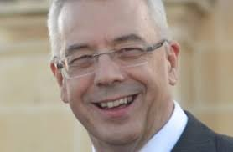
Chief and Deputy Dental Officers
SG advertised for two DCDOs (one GDS, one PDS)
Role and remit includes:
GDS experience
4 days per week
Requirement to be in employment to be considered
CDO cancels attendance at conference

Slide 31
Scottish Government
SG informed us that it is following strict pre-election guidance and has suspended all policy discussions/meetings with SDPC during purdah in the run up to the Scottish Parliamentary Election on 6 May. This applies to all areas, not just dentistry.
The SNP manifesto stated that they are planning to make all NHS dentistry free of charge. SDPC were not consulted on this.

Slide 32
DDRB :
The Doctors and Dentists Review Body
This is the independent body which takes evidence from the four UK devolved administrations and from the BDA and recommends on pay uplift for Doctors and Dentists.
We have questioned their independence as the Scottish Government reminds them of fiscal limitations and public sector pay caps when recommending uplifts. SG are not obliged to accept their recommendations. We do liaise with the BMA on the DDRB process.
SG evidence stated that GDPs were relatively highly paid professionals who can adjust their working week for a better work life balance.

Slide 33
Pensions
The NHS superannuation scheme has three schemes running
1995 scheme. Normal retirement age 60
2008 Scheme; NRA 65
2015 scheme NRA 67
We had no choice but to enter the 2015 scheme with some protection dependent on age, where some were retained in the 1995 scheme dependent on age.
This was clear age discrimination and a test case was brought by the firefighters and judges. This was the McCloud Sergeant case which the Government lost on appeal.
They lost on the basis that these transitional arrangements in 2015 were discriminatory on grounds of age. There is currently a consultation ongoing on how to remedy this discrimination with the remedy period being 1/4/2015 - 31/03/2022.

Slide 34
Pensions continued
Choice between Deferred and Immediate:
There will be a choice exercise offered to members for the remedy period:
Deferred - at retirement you will have the choice of having the best pension benefit that suits your circumstances which will depend on factors including when you retire and length of time in the various schemes.
Immediate - you can choose which scheme you wish to receive your benefit from.
Early retirement before your normal retirement age
Retiring early is an option for reduced benefit - approx. 5% per year.

Slide 35
Contributions
Annual Allowance (AA) £40,000
This is not £40,000 in contribution but sum of a calculation based on contribution and indexing factors. It is important to get this figure from SPPA on an annual basis. It is found on the Annual Allowance Pension Savings Statement and is shown as the Pension Input amount (PIA).
If you exceed the £40,000 you are not entitled to tax relief on amounts exceeding this, unless you have carry back allowance.
This is further complicated by a reduction in the AA for higher earners. If you breach the Threshold Income (TI), effectively your taxable income which is now £200,000 having been significantly increased this year by the Chancellor and Adjusted Income ( taxable income plus pension growth, now £240,000) your AA will be reduced.
Benefit Statement
SPPA produce a benefits statement which will show you how close you are to your lifetime allowance, which is currently £1.073m.

Slide 36
